Slide 1


Fundamentals of RM
RM System and Process
Leadership in RM
Incident Investigation
RM Tools & Challenges
RM in Industry
People & Org.
Application and Perspectives
On Becoming a
Leader in Risk Management
ENGG404 - Lecture
Chapter 6.2: Safety Metrics,
Lagging and Leading Indicators

Slide 2
Learning Outcomes:
Explain leading indicators and lagging indicators, and the difference between them.
Explain how applying leading indicators can:
Measure the overall effective implementation (execution) of a risk management program.
Identify deficiencies (degradation, deterioration) of critical safety conditions and critical safety rules for both occupational safety and technical safety.
Chapter 6.2: Safety Metrics, Lagging and Leading Indicators
2
Notes:
2

Slide 3
ALE #1: Identify Leading and Lagging Indicators
Please confer (MM-Poll):
Are these indicators “lagging” or “leading”?
Number of occupational injuries reportable to the gov’t per month
Number of SC’s and SP’s reported per month
Number of data breaches per year
Number of attempts to defeat the security firewall per day
Number of over-pressure vessel failures in the plant life
Number of over-pressure relief valves overdue for service
Number of fasteners found under-torqued on a bridge construction inspection
Number of steel members with loose fasteners
Number of steel members damaged under load
Number of over-current breaker trips per month
Number of motor burn-outs per year
Number of unsuccessful attempts to breach the fire-wall
Number of significant near-miss events where the consequences could have been catastrophic
Chapter 6.2: Safety Metrics, Lagging and Leading Indicators
3
Notes:
3

Slide 4
Examples: Leading and Lagging Indicators
Leading indicators are used to determine the effectiveness of certain elements in a risk management program, and where there is no consequence.
Lagging indicators are the results, the outcomes of potential weaknesses in certain elements in a risk management program, and usually where there is a consequence i.e. a loss.
Number of occupational injuries reportable to the gov’t per month LAG
Number of SC’s and SP’s reported per month LEAD
Number of data breaches per year LAG
Number of attempts to defeat the security firewall per day LEAD
Number of over-pressure vessel failures during the plant life LAG
Number of over-pressure relief valves overdue for service LEAD
Number of fasteners under-torqued on a bridge construction inspection LEAD
Number of steel members with loose fasteners LEAD
Number of steel members damaged under load LAG
Number of over-current breaker trips per month LEAD
Number of motor burn-outs per year LAG
Number of unsuccessful attempts to breach the fire-wall LEAD
Number of significant near-miss events where the consequences could have been catastrophic were it not for some “lucky” factor e.g. a person was almost struck by a falling structure and could have been killed. LAG or LEAD – depending on the reporting criteria of the organization; Generally, if no loss, it is tracked as a LEADING indicator because this metric is usually not reported up through the organization
Chapter 6.2: Safety Metrics, Lagging and Leading Indicators
4
Notes:
4

Slide 5
Lagging Indicators – General Examples:
Lagging indicators track incidents with consequences:
  Number of incidents with consequences reported
  Number of incident investigations on incidents with consequences performed
  Number of first aid cases
  Number of serious injuries
  Number of fatalities
In other words, something bad happened to create the data point!
Metrics derived from The Incident
Pyramid
WITH
Chapter 6.2: Safety Metrics, Lagging and Leading Indicators
5
Notes:
5

Slide 6
Lagging Indicators – Specific Definitions:
Three of many different metrics:
  Three specific metrics, all of which are lagging indicators, use recordable injuries to quantify a company’s safety performance:
  Fatal Accident Rate (FAR) – UK
  Total Recordable Incident Rate (TRIR) – USA
  Lost Time Incident Rate (LTIR) – USA
See Topic #9 Chapter 2.1:Why is Risk Management Important? for an example on how to calculate an IR.
  There is no federal roll-up statistic for Canada. Each province tracks, usually as “Lost Time injury (or Incident) Rate” per provincial Workers’ Compensation Boards, and the Association of WCB’s does a roll-up.
  Most organizations operating in Canada with an American parent company usually report internally with TRIR and LTIR
Chapter 6.2: Safety Metrics, Lagging and Leading Indicators
6

Slide 7
Lagging Indicators – Specific Definitions:
Fatal Accident Rate (FAR) – UK
  Fatality only – no other kind of injury: a worker was killed on-the-job or due to a chronic work-related illness e.g. cancer, asbestosis, silicosis.
  Number of fatalities per 1000 worker-working-lifetimes for an activity (~100,000,000 working hours)
  FAR: expressed as the number of fatalities per 1000 worker-working lifetimes:
    FAR = (# of fatalities * 100,000,000) / (# of hours worked)
    100,000,000 = 1000 workers * 50 years * 50 weeks / year * 40 hours/week
Total Recordable Incident Rate (TRIR) – USA
  Recordable incidents: fatalities; hospitalizations; injuries and illnesses that lead to medical treatment beyond first aid i.e. lost-time injury aka days-away-from-work cases, restricted-work cases, or job-transfer-due-to-injury cases
  TRIR: expressed as the number of recordable injuries per 200,000 worker-hours (1 year)
    TRIR = (# of recordable incidents* 200,000) / (# of hours worked)
Lost Time Incident Rate (LTIR) – USA
  Lost time incidents: Injury incidents where medical treatment is given and results in time-away-from-work for the injured worker.
  LTIR: expressed as the number of lost-time injuries per 200,000 worker-hours (1 year)
    LTIR = (# of lost time incidents * 200,000) / (# hours worked)
    Nominal organization: 100 workers * 40 hours/week * 50 weeks/year = 200,000 worker-hours
    For purposes of this course, TRIR and LTIR are the same, and can be referred to as simply “Injury Frequency Rate” (IFR).
Chapter 6.2: Safety Metrics, Lagging and Leading Indicators
7

Slide 8
Lagging Indicators – Challenges and Limitations:
Challenges and limitations with using lagging indicators include:
Even though lagging indicators include both occupational and technical safety, there tends to be an over-emphasis on occupational injuries.
Not all are reported or investigated.
Negative trends can create “knee-jerk” reactions.
Positive trends are not appropriately resourced.
  A short-term positive trend could be mis-managed as “We have solved the problem. The issues are behind us.”
Cannot be used as a means to influence safety culture for effective and sustainable performance improvements.
Especially for technical safety incidents, there may be long durations of “positive” performance between events
  This can “lull” the organization into a false sense of “security” and the RM program is “invulnerable” or at least “robust”.
  Recall, technical safety incidents are extremely low likelihood with extremely high (catastrophic) consequences.
Chapter 6.2: Safety Metrics, Lagging and Leading Indicators
8
Notes:
8

Slide 9
Leading Indicators – Examples:
In contrast, the leading indicators are created as a result of a proactive audit that is intended to assess the effective implementation of the RM program. These audits can be tracked on a “rate” basis e.g. # per week, # per hours of operation, etc.
    # of administrative controls reviewed and updated
    # of inspections on safety equipment carried out, RME #8 O&M
    # of workers with up-to-date qualifications, RME #9 EC&T
    # of management safety audits completed, RME #6 PECI
    # of changes appropriately managed, RME #4 MOC
    # of job observations and planned inspections carried out
    # of safety systems disabled or bypassed
    # near miss incident reports received and reviewed
    # near miss incident reports addressed
    # of SC and SP reports received and reviewed
    # of SC and SP reports addressed
    # safe behavior awards presented to workers
In other words, look for signals (the data points) before something bad happens!
Chapter 6.2: Safety Metrics, Lagging and Leading Indicators
9
Notes:
A more proactive approach is the use of leading indicators, which are measures or activities taken to prevent incidents from occurring. If used correctly, leading indicators focus resources on incident prevention, as well as allow management to actively demonstrate leadership and empower workers to engage in discussions about how to prevent future incidents. Leading indicators must be measurable, positive, simple, and result in incident prevention. In other words, personnel resources and time focused on tracking leading indicators should result in a positive focus on safety and incident prevention (i.e. what you want to achieve, not the negative results). The choice of leading indicators are specific to the organization and its activities, but some common ones consist of the following:

Slide 10
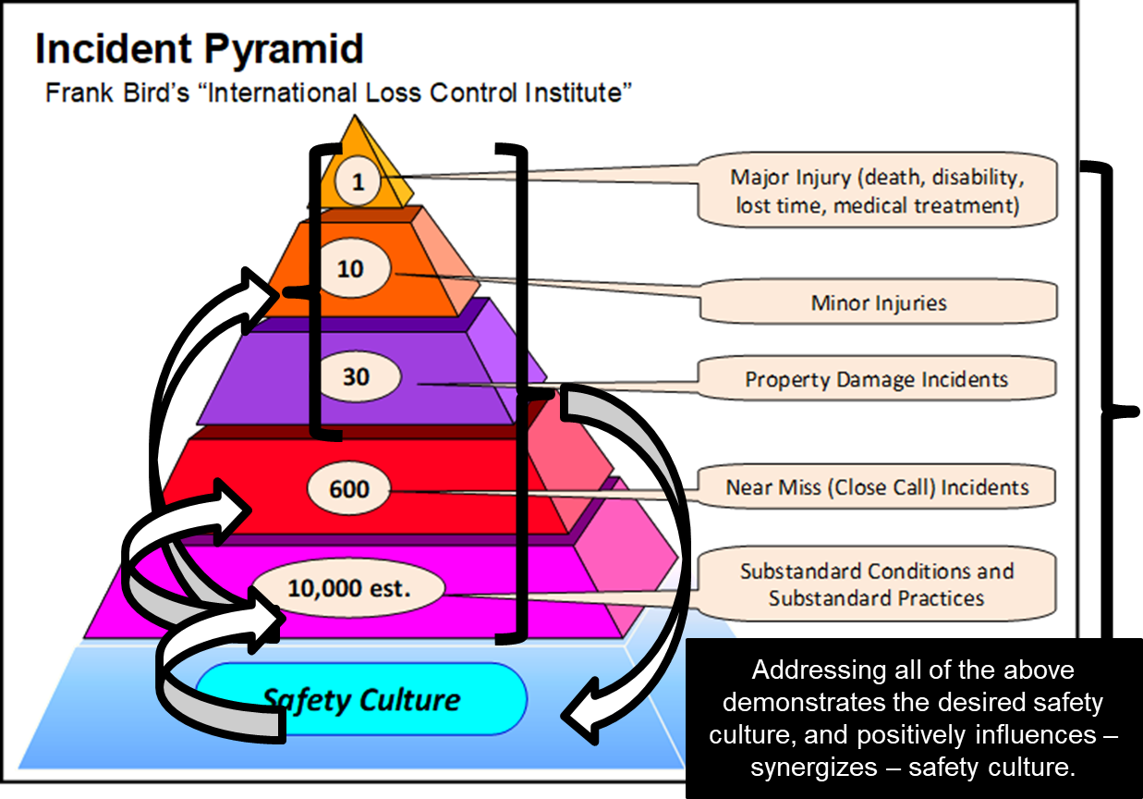
Leading Indicators – Benefits:
Can be directly used by leaders to influence the safety culture!
This concept is further explored in Chapter 7.
Chapter 6.2: Safety Metrics, Lagging and Leading Indicators
10
Notes:
10
Leading indicators measure the effective implementation of controls that manage risks. With effective controls in place, as measured by the leading indicators, risks are managed and a loss incident is avoided. In contrast, when controls are not effective, as measured by the leading indicators, risks are not managed as best they can be, and a loss incident can occur. By measuring leading indicators, the “early signals” of deficiencies or inadequacies in the risk management program can be detected, and action can be taken to correct before a loss incident occurs.

Slide 11
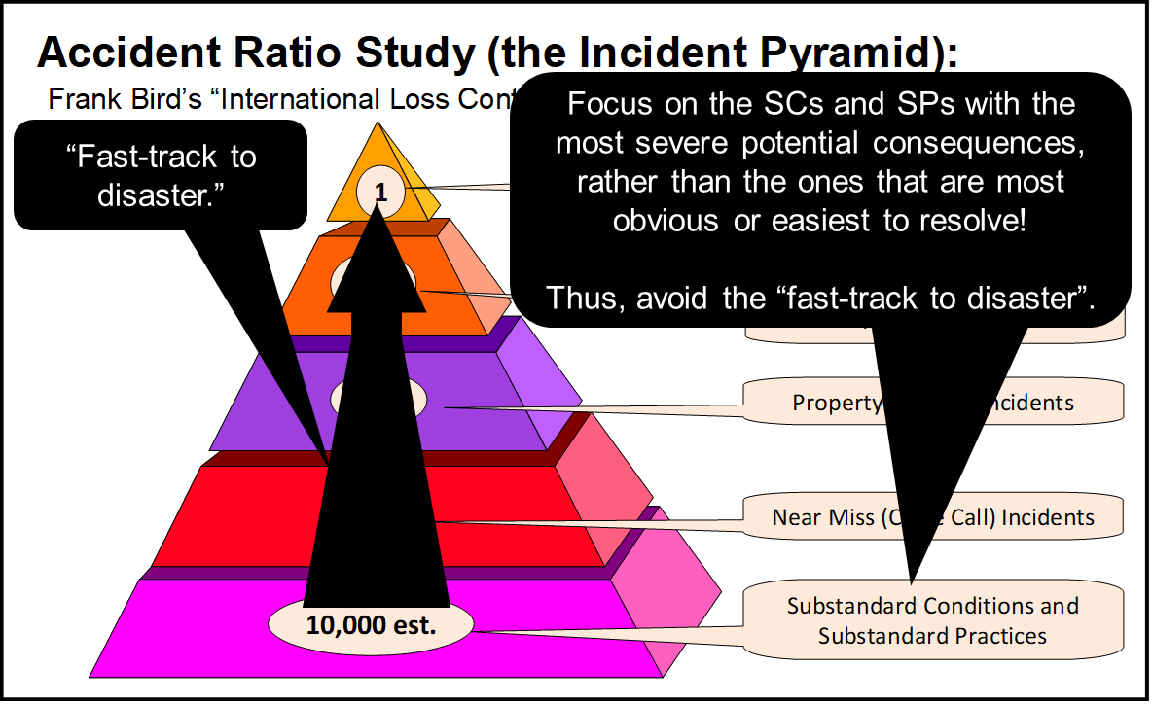
Leading Indicators – Benefits:
For technical safety incidents, the implementation of the RM program is measured on an on-going basis using leading indicators, and proactive action can be taken to address deficiencies before a loss incident occurs.
“Early signals” for critical sub-standard conditions and sub-standard practices, when the risk level increases substantially, can be used to inform leaders in the allocation of resources to address these; thus avoiding situations where “one small misstep” can lead to a catastrophic event i.e. the “fast track to disaster”.
Chapter 6.2: Safety Metrics, Lagging and Leading Indicators
11
Notes:
11

Slide 12
ALE #2: Allocate Resources Based on Indicators
Please confer (MM-Poll):
You are the most senior engineer (in terms of technical expertise) in your company and have a thorough and detailed knowledge of the technology applied in your company’s projects. You receive weekly reports on leading indicators for the numerous bridge construction and bridge rehabilitation projects for which you have technical oversight across the company.
Rank these metrics (all are reported weekly and are based on planned inspections, and all are above an acceptable limit) in order to allocate resources for resolving, first to fourth:
Number of SP’s reported that solely pertain to lack of PPE
Fraction of fasteners inspected and found under-torqued on new or rehab bridge construction
Fraction of metal surface areas with defective protective coating
Number of times that flagging personnel unnecessarily delayed local traffic
Chapter 6.2: Safety Metrics, Lagging and Leading Indicators
12
Notes:
12

Slide 13
Examples: Allocate Resources Based on Indicators
You are the most senior engineer (in terms of technical expertise) in your company and have a thorough and detailed knowledge of the technology applied in your company’s projects. You receive weekly reports on leading indicators for the numerous bridge construction and bridge rehabilitation projects for which you have technical oversight across the company. You decide to allocate resources to address the issues in this order:
Fraction of fasteners inspected and found under-torqued on new or rehab bridge construction (consequence: imminent structural collapse)
Fraction of metal surface areas with defective protective coating (consequence: extensive future repairs or delayed structural collapse)
Number of SP’s reported that solely pertain to lack of PPE (consequence: limited to injury to the one individual)
Number of times that flagging personnel unnecessarily delayed local traffic (consequence: none on PEAP)
Chapter 6.2: Safety Metrics, Lagging and Leading Indicators
13
Notes:
13

Slide 14
Summary and Key Lessons:
Summary:
Lagging indicators are “after the fact” of a loss incident.
Superior organizations use leading indicators to
measure the effectiveness of a RM program i.e. look at the effective and compliant work execution of administrative controls and effectiveness of engineered systems.
improve safety culture,
promote communication,
prevent incidents,
ultimately improve safety performance.
Metrics are based on “counts”, and a meaningful “rate” can be determined, standardized, applied, monitored, and tracked.
Key Lessons
Leaders can use leading indicators to:
Measure the overall effective implementation (execution) of a risk management program.
Identify deficiencies (degradation, deterioration) of critical safety conditions and critical safety rules for both occupational safety and technical safety.
Chapter 6.2: Safety Metrics, Lagging and Leading Indicators
14
Notes:
14

Slide 15
Any questions?
Notes:
15

